Slide 1

Increasing Access to Tobacco Cessation: Using Mobile Apps to Improve Public Health
Ask Advise Refer: Free Tobacco Cessation Resources

Slide 2
Overview
Tobacco cessation through systems change
The Texas Quitline
Ask-Advise-Refer: resources for tobacco cessation
Notes:
<Review the key points to be covered, and include any others that you wish to cover that are not yet in the presentation>,.
This is a quick overview of the presentation today; we will review the Texas Quitline, resources to help patients quit tobacco using an app, and how we can be a resource to you.

Slide 3
Overview
Dangers Of Tobacco Use
Tobacco Use And High Risk Populations
Tobacco Products And Marketing
National Guidelines And Policies
Ask-Advise-Refer
Referral Tools
Connecting to Your Community
Notes:
Review the points above

Slide 4
Objectives
In this training you will learn about the following:
The high impact of tobacco use on people, especially youth, people with chronic health disorders and those with other substance addictions
New tobacco products being marketed in our communities
The Texas Quitline and the tobacco quitline services available to support anyone who is ready to quit
Referral tools that can help providers and community coalitions work together to increase tobacco cessation in our communities
Discuss ways to engage in dialogue with people about quitting tobacco
Notes:
Review objectives and explain the group break-out session that will help to leverage all of the information learned in order to help clients we serve.

Slide 5
Pre-presentation Discussion
What do you know about
Tobacco use in the community?

Slide 6
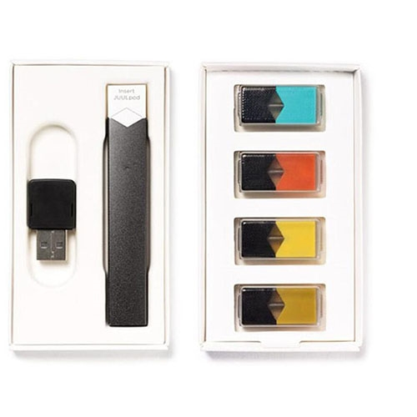
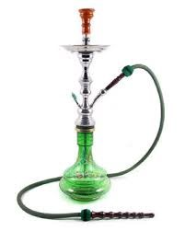
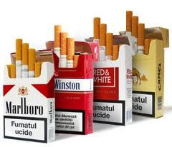
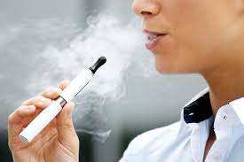
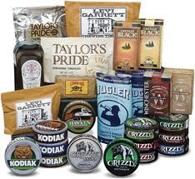
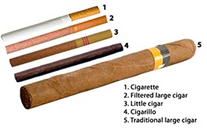
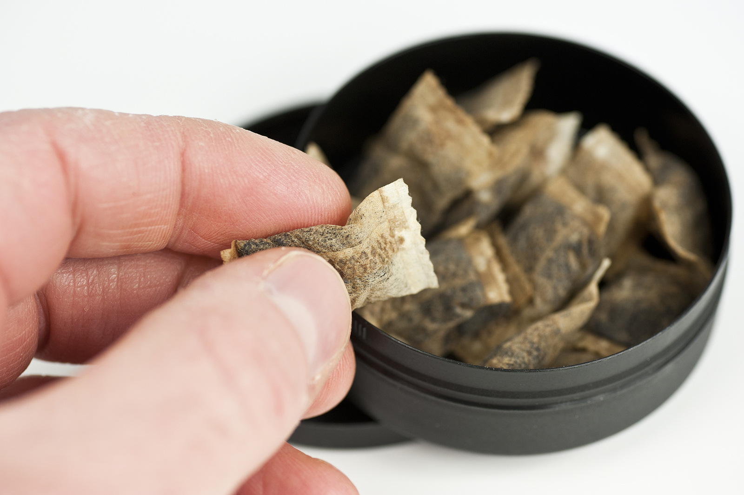
Tobacco Products
Notes:
As you know, when we speak of tobacco products, we are speaking of all of the following products.
Although not a lot of research has been conducted on electronic cigarettes, it is important to encourage health professionals to look at this issue comprehensively, to educate and be a resource for all involved.
Tobacco Products include the following:
Cigarettes
Hookah
Electronic Cigarette
Cigars/cigarillos
Chew/spit tobacco
Snus and other dissolvable products

Slide 7
Why focus on tobacco
Over $17 billion in Texas healthcare and productivity lost each year.
In Texas, over 24,000 deaths per year.
Number one cause of preventable death.
Tobacco impacts every chronic disease.
People with health disparities are impacted by tobacco at a higher rate.
Impacts people who are exposed to second-hand smoke
Impacts pregnant women and unborn child
Notes:
As you know, tobacco is the number one cause of preventable death in Texas and the entire world.
In Texas over $17 billion dollars are lost annually as a result of tobacco use and lost productivity.
Tobacco impacts many chronic diseases; this includes second-hand exposure to smoke, especially to children.

Slide 8
Adult Cigarette Smoking
According the 2017 BRFSS:
15.7% of Texas adults reported current cigarette smoking;
  A higher percentage of men (17.8%) reported current cigarette smoking compared to women (13.6%);
19.9% of Texas adults reported former cigarette smoking;
  24.8% of men reported former cigarette smoking compared to 15.2% of women;
2013
2014
2015
2016
2017
Prevalence of Current Adult Cigarette Smoking in Texas, 2013 - 2017
15.9%
14.5%
15.2%
14.3%
15.7%
*DSHS BRFSS 2017
Notes:
Among Texas adults (18+) in 2017, nearly 16% reported current cigarette smoking, when we break this down by sex, a higher proportion of men reported current cigarette smoking – 17.8% to 13.6% respectively. Additionally, roughly one in five (19.9%) reported former smoking. We can see here as well that a higher proportion of men reported former cigarette smoking.
Here we can also see the prevalence of current cigarette smoking from BRFSS going back to 2013. We’ve seen the prevalence of current smoking sort of oscillate in the past few years – though overall it has been fairly stable, around 14% to 15% and it is important to note that these differences are not statistically significant.

Slide 9
Cigarette Use
*DSHS BRFSS 2017
Notes:
Here we see the prevalence of current and former cigarette smoking by race/ethnicity. There weren’t any differences in current cigarette smoking by race/ethnicity. However, over one in four white respondents (26.7%), reported former cigarette smoking, which was the highest prevalence among all race/ethnicities.

Slide 10
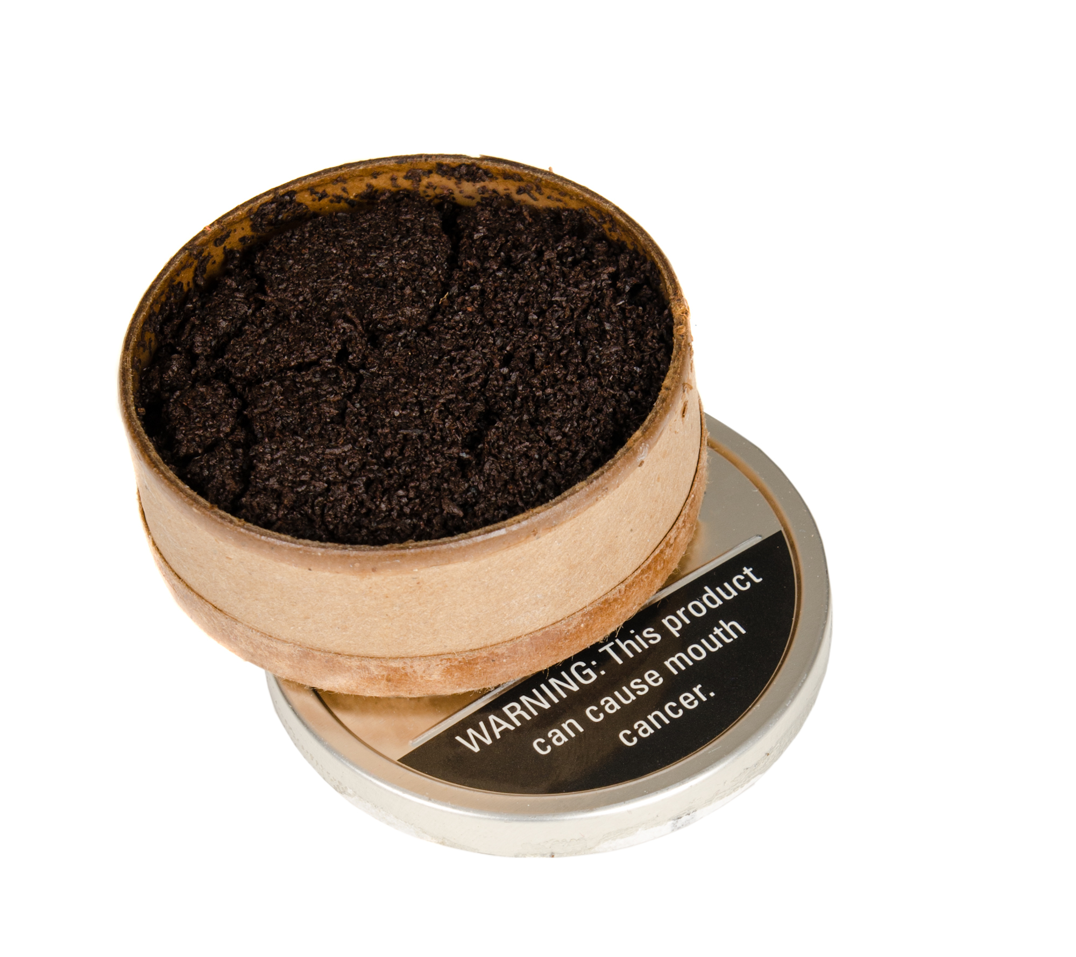
Smokeless Tobacco
Snus
Snuff
Notes:
Chewing tobacco, dip, snuff and snus are less common but still a real problem in many communities. Snus is the newest of these products and come in small pouches that can be tucked between the cheek and gum.

Slide 11
Adult Smokeless Tobacco Use
According to the 2017 BRFSS:
4.3% of Texans reported current smokeless tobacco use;
7.5% of men reported current smokeless tobacco use compared to 1.1% of women;
2013
2014
2015
2016
2017
Prevalence of Current Adult Smokeless Tobacco Use in Texas, 2013 - 2017
4.3%
4.2%
4.0%
4.3%
4.3%
*DSHS BRFSS 2017
Notes:
4.3% of Texas adults in 2017 reported current smokeless tobacco use in 2017. As you can see, there was also a fairly large difference in prevalence between men and women, with 7.5% of men reporting current smokeless use compared to 1.1% of women. You can also see that the prevalence of current smokeless use has remained fairly consistent over the last five years, as it has hovered around 4% - there was no statistically significant differences between these prevalences.

Slide 12
Smokeless Tobacco Use
*DSHS BRFSS 2017
Notes:
So as we can see here, adults 18 – 44 years of age had a higher prevalence of current smokeless than those 45 years and older, though this was not statistically significant.
In our table of current smokeless tobacco by race/ethnicity, we can see that white respondents had a higher prevalence of current smokeless tobacco use compared to Hispanic respondents. It is important to note that African American respondents and other/multiracial respondents did not yield enough sample size to provide reliable estimates with respect to current smokeless tobacco use.
2.9% of college graduates reported current use of smokeless tobacco, which was significantly lower than the 5.7% of high school graduates who reported current smokeless tobacco use.
There were no significant differences between annual household income and current smokeless tobacco use, though it is important to note that respondents who reported an annual household income between $35,000 to < $50,000 did not yield enough sample size to provide a reliable estimate for current smokeless tobacco use.

Slide 13
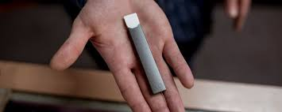

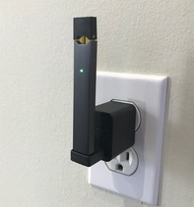
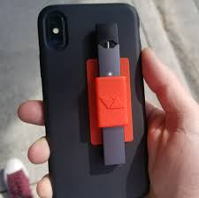
New Alternative Product: Juul
Notes:
There has been a rise in popularity of Juul, an e-cigarette, often flavored, easy to hide and looks like a USB device. According to Tobacco Free Kids that cites the National Youth Tobacco Survey, 11.3 percent of high school and 4.3 percent of middle school students, or 2 million youth, are e-cigarette users. Juul’s stated mission is to “eliminate cigarette smoking throughout the world one smoker at a time yet one Juul cartridge delivers the amount of nicotine equivalent to one pack of cigarettes, according to their website. Many youth and young adults refer to Juul use as “Juuling”, not vaping. More information is available here: https://truthinitiative.org/news/what-is-juul

Slide 14
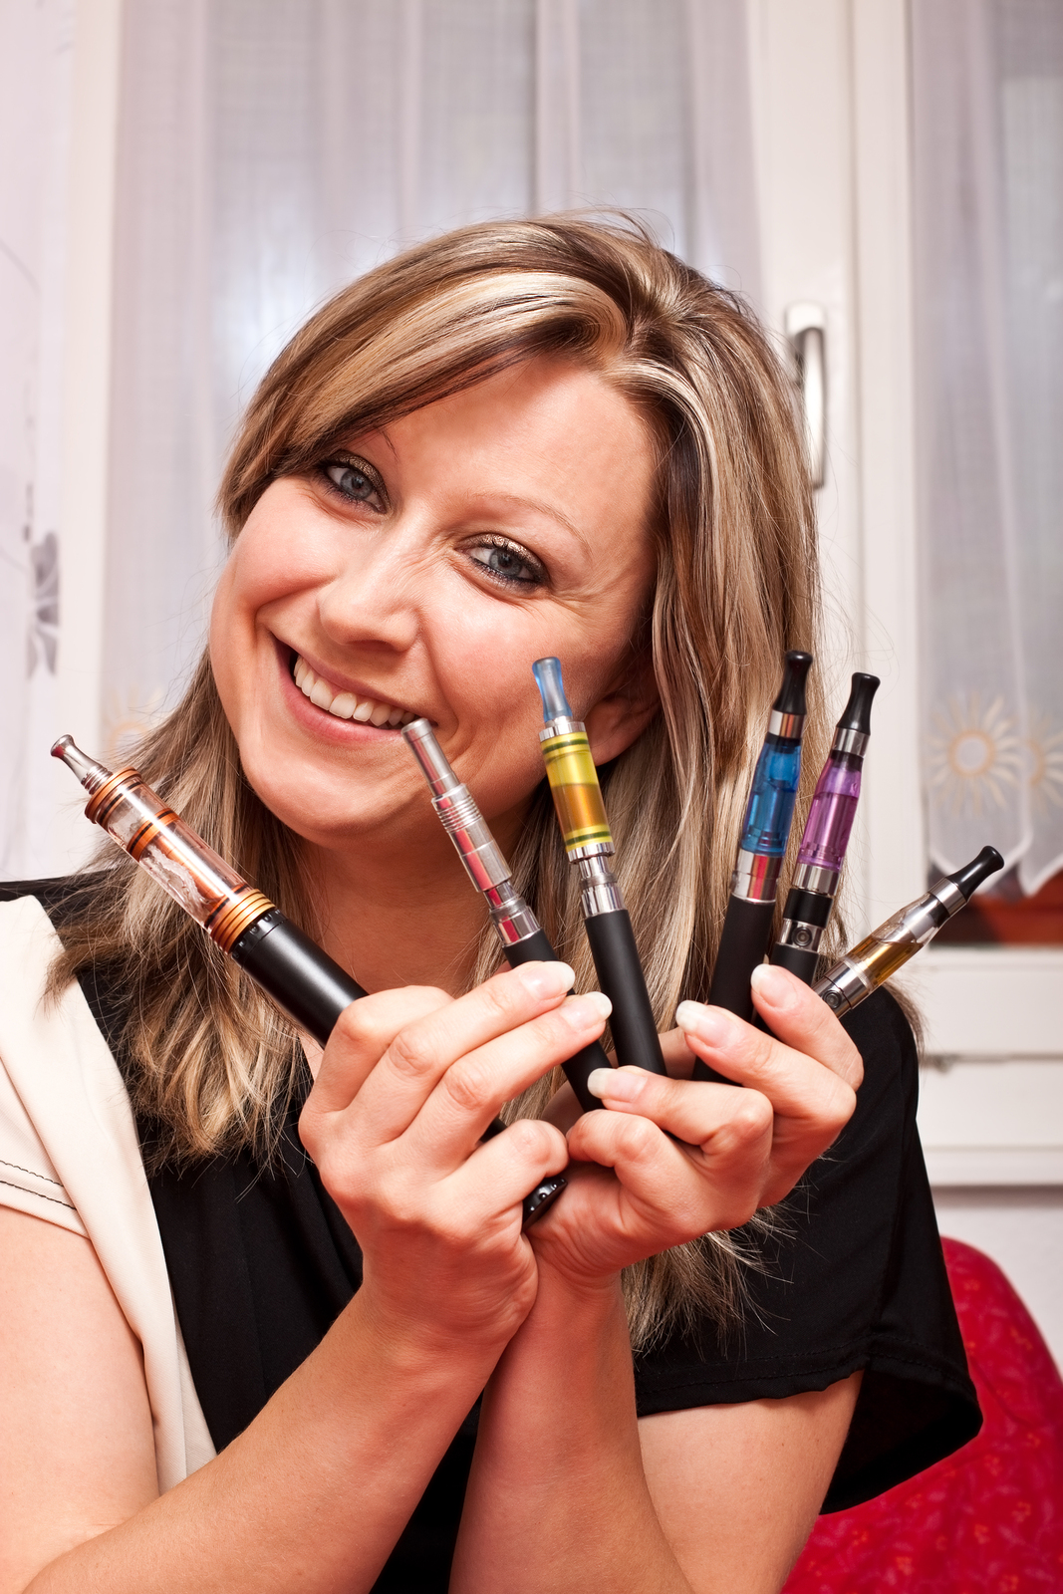
Alternative Tobacco products:
E-Cigarettes and Vaping
e-Cigarettes and Juuls are unregulated—therefore all of the contents are unknown.
The dangers unknown—although thought to be a potential risk reduction strategy for traditional users.
Major concern: dual use.

Slide 15
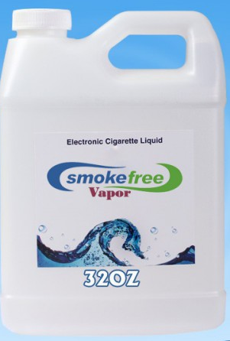
Tobacco Products: E-Cigarettes
946,000 mg of pure nicotine from an e-liquid website.
At least 10 chemical ingredients documented carcinogens
Enough to kill approximately 19,000 humans.
Nicotine is an extremely toxic chemical
Notes:
*The e-liquid can be purchased online in great quantity, 946,000 mg of pure nicotine.
*E-cigarette aerosol is made up of a high concentration of ultrafine particles; the particle concentration is higher than in conventional tobacco cigarette smoke.
* Exposure to fine and ultrafine particles may exacerbate respiratory ailments like asthma, and constrict arteries which could trigger a heart attack.
* At least 10 chemicals identified in e-cigarette aerosol are on California’s Proposition 65 list of carcinogens and reproductive toxins, also known as the Safe Drinking Water and Toxic Enforcement Act of 1986. The compounds that have already been identified in mainstream (MS) or secondhand (SS) e-cigarette aerosol include: Acetaldehyde (MS), Benzene (SS), Cadmium (MS), Formaldehyde (MS,SS), Isoprene (SS), Lead (MS), Nickel (MS), Nicotine (MS, SS), N-Nitrosonornicotine (MS, SS), Toluene (MS, SS).
Americans for Nonsmokers' Rights, © 2014
Liquid nicotine and other devices are also a risk to pets and young children; devices often appear to be toys that make them appealing to children. The batteries in these devices may also be a risk.

Slide 16
Adult ENDS Use
According to the 2017 BRFSS:
4.7% of Texans reported current ENDS use;
16.0% of Texans reported former ENDS use;
5.5% of men, and 4.0% of women, reported current ENDS use, though this difference was not statistically significant;
23.4% of men reported ever using or trying ENDS compared to 18.3% of women;
2015
2016
2017
Prevalence of Current Adult ENDS Use in Texas, 2013 - 2017
4.8%
4.7%
4.7%
Notes:
Overall, 4.7% of Texans reported current ENDS use in 2017, and 16.0% reported former ENDS use. Although 5.5% of men reported current ENDS use – compared to 4.0% of women – this difference was not significant. While we didn’t see any significant differences between men and women for current or former ENDS use, we did see a higher percentage of men (24.3%) reported ever using or trying ENDS use compared to women (18.3%). Since ENDS are a relatively new and emerging tobacco product, we do not have as many years of data compared to the other tobacco products, though as we can see here, the prevalence of current ENDS use has been between 4.7-4.8 since 2015.

Slide 17
ENDS Use by Age
Notes:
Here we have current and former ENDS use by age group. Responses from adults 65 years and older did not yield statistically reliable estimates for ENDS use. However, 8.5% of young adults (ages 18-29) reported current ENDS use, which was significantly higher than the 4.1% of adults 45 to 64 years of age who reported current ENDS use. One in four adults aged 18-29 and one in five adults aged 30 to 44 reported former ENDS use, and both groups had a higher prevalence compared to adults aged 45 to 64.

Slide 18
ENDS Use
Notes:
2.1% of college graduates reported current ENDS use, which was significantly lower than both high school graduates (6.5%) and respondents who reported some college (5.8%). Interestingly, high school graduates and respondents reporting ‘some college’ had significantly higher proportions of former ENDS use compared both respondents reporting less than high school and college graduates.

Slide 19
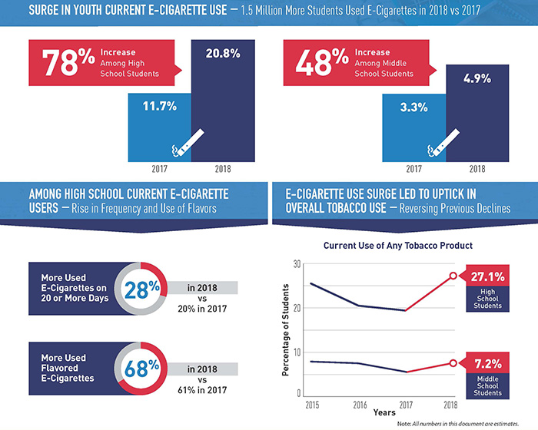
*YTS 2018
Notes:
Youth are also using the electronic nicotine delivery systems at an alarming rate. The increase in e-cig use The increase in use of e-cigarettes among high school students is reflected in the reverse of what had been a downward trend in current any tobacco use.

Slide 20
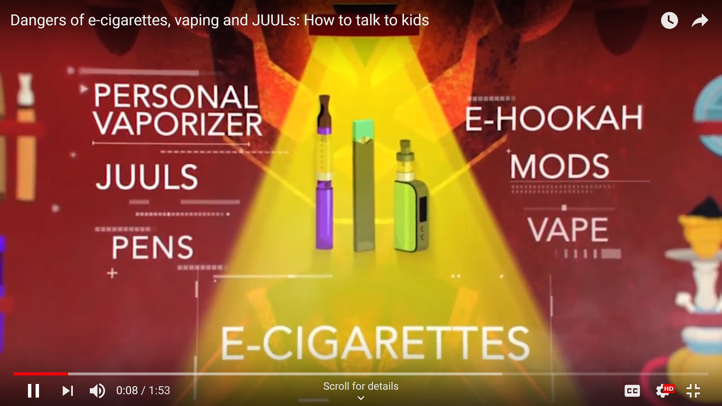
https://www.youtube.com/watch?v=6JCAyb3lDTo

Slide 21
Tobacco Advocacy:
A little history

Slide 22
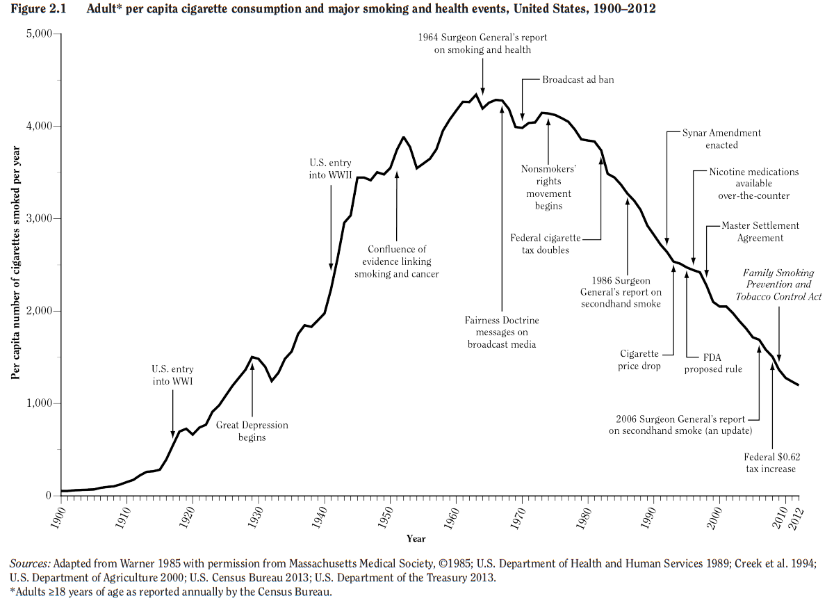
Notes:
This slide shows a period of about 22 years, 1990-2012, and a series of events that have impacted tobacco.
(Explain the slide and that the peak means.)

Slide 23
comprehensive Plan for
Tobacco and nicotine regulation
  FDA’s overarching goal: a world where cigarettes can no longer create or sustain addiction, and where adults who still seek nicotine could get it from potentially less harmful sources.
  development of a product standard to lower nicotine in cigarettes to minimally or non-addictive levels
  Proposing new rules that will require product information, manufacturing practices and filing retail applications to ensure that they meet the legal requirements.
Notes:
FDA Comprehensive Plan For Tobacco And Nicotine Regulation
https://www.fda.gov/TobaccoProducts/NewsEvents/ucm568425.htm

Slide 24
Addressing youth tobacco use
The Fda’S Youth tobacco plan priority areas
Preventing youth access
Regulating Marketing
Educating Teens and Retailers
Notes:
Youth Tobacco Plan
https://www.fda.gov/TobaccoProducts/PublicHealthEducation/ProtectingKidsfromTobacco/ucm608433.htm

Slide 25
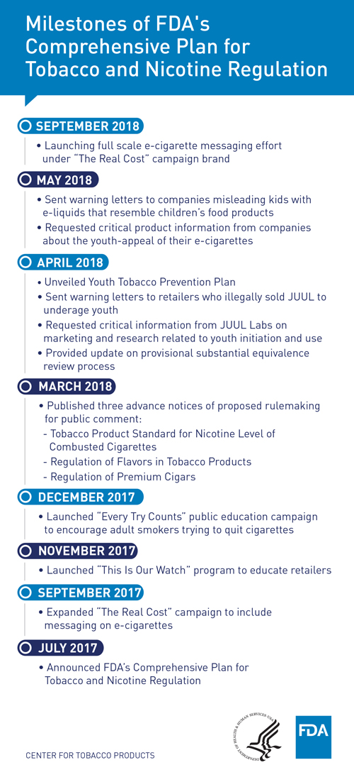
Milestones of FDA’s Comprehensive Plan for Tobacco & Nicotine Regulation

Slide 26
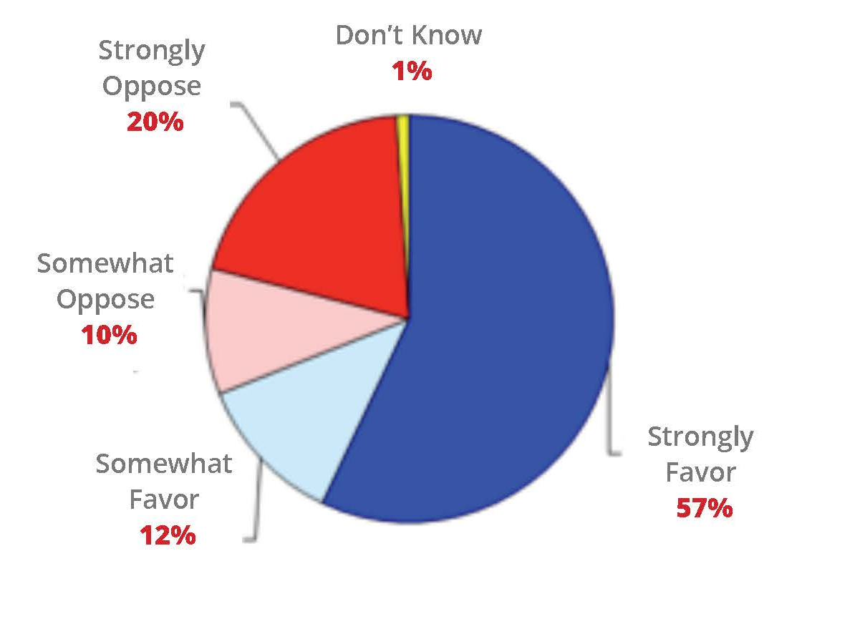
Texas Tobacco 21
Texas 21 is a coalition of organizations whose mission is to save lives by preventing tobacco use.
About 95% of smokers start before age 21. In Texas, 10,400 kids become daily smokers every year. And one-third of them will die prematurely as a result.
In Texas, nearly 70 % of voters support a law to raise the tobacco sales age to 21.
www.Texas21.org

Slide 27
Advocating for Tobacco policies for your Community
Write a letter to the editor
Call a talk show
Send a letter to your legislator (School Board member, city Council, County commissioner)
Meet a legislator face to face
Social media outreach (@TexasTobacco 21, @acscantexas, @peersagainsttobacco, etc)

Slide 28
Tobacco products:
Marketing then and now

Slide 29
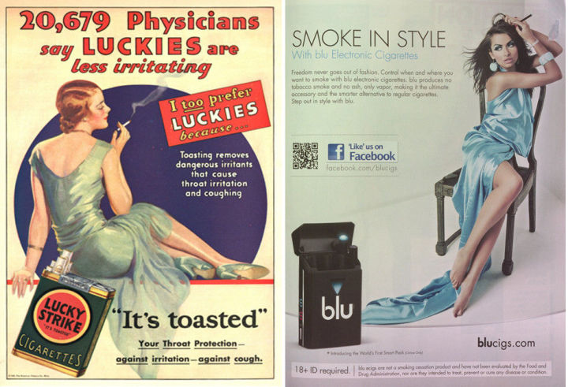
1930 vs 2012
Notes:
The photo on the left represents a cigarette ad in the year 1930.
The photo on the right, represents the electronic cigarette in 1912.

Slide 30
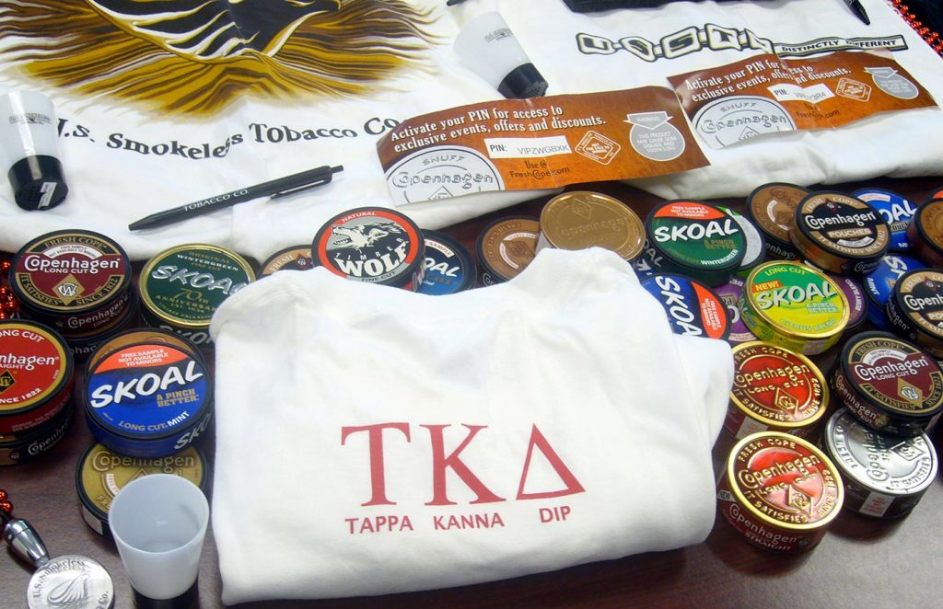
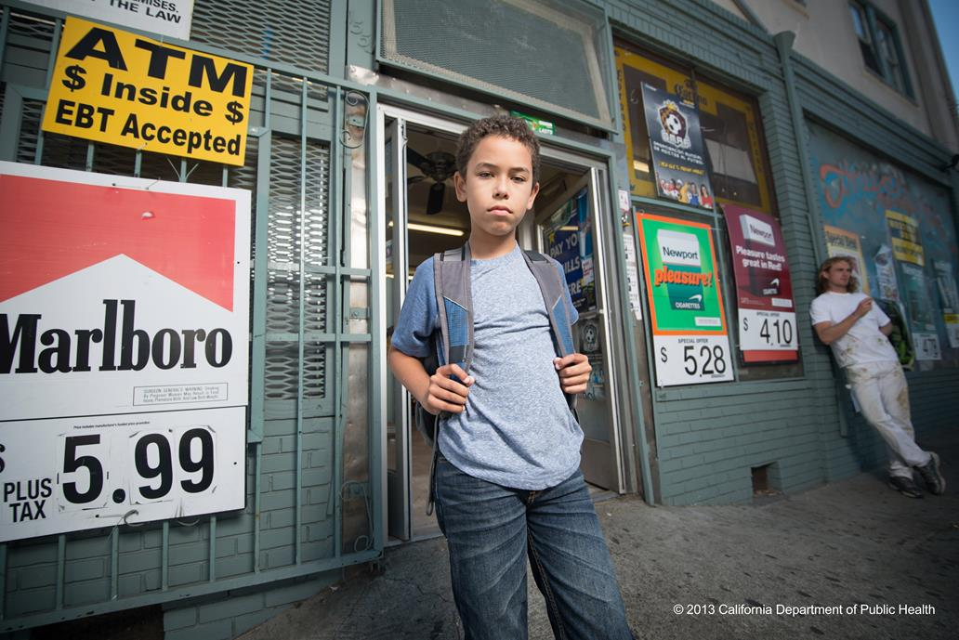
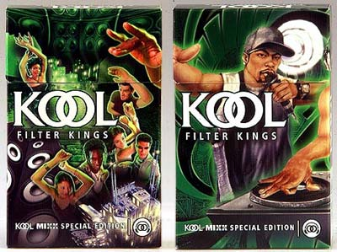
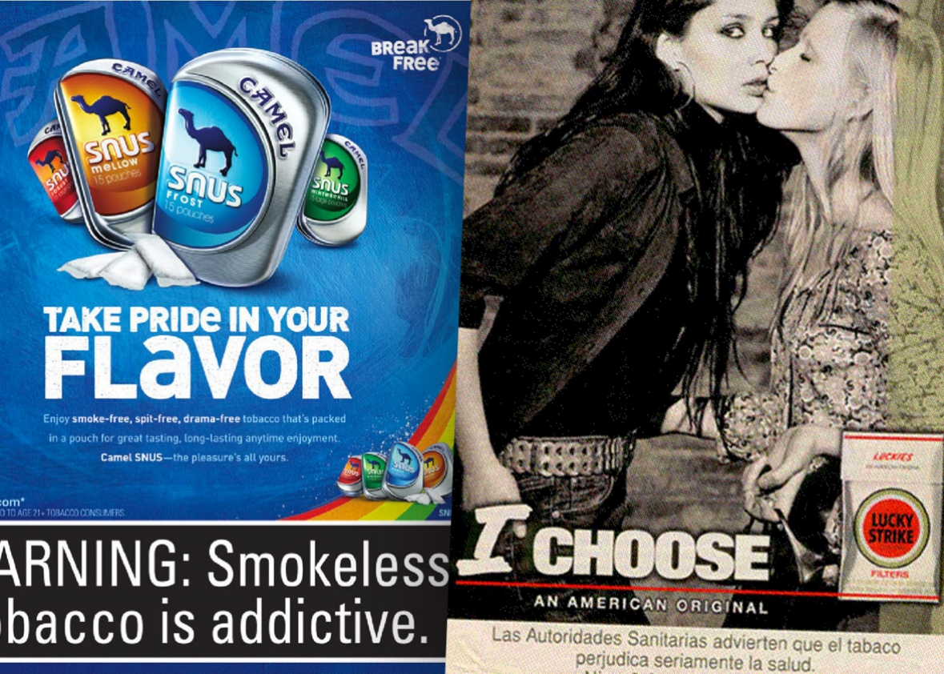
Marketing Tobacco
Advertising that is attractive to youth
Themes exploit personal values
Targets diverse communities such as gay men, African American and Hispanic-Latino communities
Sponsorship of diverse events including using languages other than English
Contributions to community organizations
Marketing campaigns that hide the truth, e.g. “Tobacco is wacko” (adolescents)
Lack of truth about the danger of tobacco and risk of addiction
Notes:
Some of the tactics used in tobacco marketing are the following:
<read the slide>
Do any of these ads look familiar? What do you see in your community? In events?

Slide 31
What do you see as the most pressing issue related to tobacco products and the populations you serve?
Notes:
1) Follow up questions: What products do you see in you community?
2) How have you seen things evolve as new tobacco products become available?

Slide 32
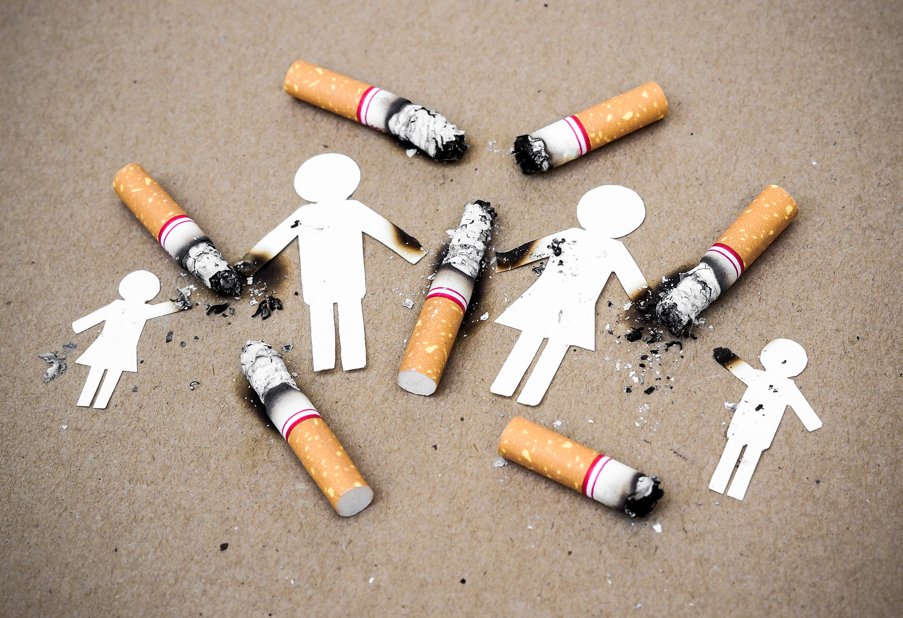
Dangers of tobacco use in the USA:
46.6 million adults age 18+ are smokers
Approximately 443,000 adults die annually from an illness attributed to smoking
8.6 million people live with a serious illness caused by smoking
$17.5 billion annual medical costs due to smoking
Notes:
* Centers for Disease Control and Prevention. Best Practices for Comprehensive Tobacco Control Programs – 2007, p. 15. Atlanta: U.S. Department of Health and Human Services, Centers for Disease Control and Prevention, National Center for Chronic Disease Prevention and Health Promotion, Office on Smoking or Health; October 2007.

Slide 33
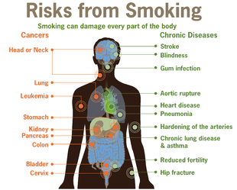
Dangers of tobacco use
Cancer
Smoking causes 90% of lung cancer deaths in women and 80% in men
Cardiovascular Disease
Asthma & other Respiratory Diseases
Diabetes
Male and Female Fertility
Notes:
Not only does tobacco contribute to every chronic disease, it also harms nearly every organ in the body.
Cigarette smoking is the leading cause of preventable death in the United States. Tobacco also places men and women’s fertility at risk and impacts many other areas of health including vision and oral health.
Tobacco control seeks to end the death and disease caused by tobacco use and by exposure to secondhand smoke. But, unlike diphtheria, pertussis, or tetanus, there is no vaccine to inoculate people against tobacco’s harmful effects. Instead, individuals, agencies, and organizations must work together to take on a complex mix of social, cultural, economic, and political issues which encourage tobacco use (Tobacco Technical Assistance Consortium, 2004).
Quitting tobacco may take several attempts. We will discuss this later when we present the details on the Help to Quit app.

Slide 34

The dangers of tobacco use
500
400
No.
(000s)
300
200
100
0
Annual
smoking
deaths
Environmental
tobacco smoke
deaths
All
World
War II
Annual auto
accidents
Vietnam
War
AIDS
1983-1990
Annual
murders
Annual heroin,
morphine & cocaine
deaths
CP1146669-2
Notes:
Everyday smoking kills the equivalent of three 747 jets full of passengers, yet we never hear about the danger of tobacco on a daily basis. The death toll is more than any other public health concern.

Slide 35
Behavioral Health and Tobacco use
31% of cigarettes smoked in the U.S. are consumed by individuals with a psychiatric or substance abuse disorder
An estimated 200,000 smokers with mental illness or addiction die each year due to tobacco use
  Approximately ½ of all tobacco-related deaths
  Die 25 years younger than the general population largely due to smoking related illnesses
  Highly disproportionate to the number of those with mental disorders in the general population
        (CDC, 2013, NASMHPD Toolkit 2007)
Notes:
31% of cigarettes smoked –36% of those with mental illness diagnosis and 50% of those with substance abuse
SA recovery is not jeopardized by tobacco cessation, in fact abstinence is positively linked to it. (25% more likely to report long term abstinence)
In 2006 the American Psychological Assoc. reported that Tobacco use can actually harm recovery by triggering other cravings.

Slide 36
Behavioral Health and Tobacco use in Texas
DSHS-funded Substance Abuse
Treatment Centers
Intake/Assessment
  70% Adult Smoking Rate vs. 18.5% of Texas general population
  39% Youth Smoking Rate vs.11.2% of Texas youth population
  (2011 Clinical Management for Behavioral Health Services)
Notes:
13% Co-Occurring Mental Health and Substance Dependence Diagnosis
1.85% Co-Occurring Mental Health and Substance Dependence Diagnosis

Slide 37
Behavioral Health and Tobacco use in Texas
Higher smoking rate
Less cessation, increased usage
Higher rates of morbidity and mortality
Disparate population
Notes:
People with a mental illness diagnosis are 20% of the population but they represent 50% of the premature deaths due to tobacco use.
- People w a MI diagnosis who smoke tend to die 25 years earlier than those w/o tobacco addiction…Smoking is the leading cause
50% of people recovering from substance abuse who continue to smoke, die of tobacco related illnesses

Slide 38
Behavioral Health and Tobacco use in Texas
64.6% Quitline Callers Report Mental Health Disorder
  Depression: 21%
  Anxiety Disorder: 17%
  Bi-Polar Disorder: 10.2%
  Drugs and Alcohol: 7%
  Post Traumatic Stress Disorder: 5.9%
  Schizophrenia: 3.5%
2014 Texas Quitline Data (July – November)

Slide 39
CDC Vital Signs: SHS in US Public Housing
One in four nonsmokers is exposed to second-hand smoke. (58 million people)
Individuals living in rental housing suffer from a higher second-hand smoke exposure.
The rate of respiratory illness is significantly higher among those living in public housing.
There are 760,00 children living in public housing.
The proposed rule restricting tobacco use in public housing will impact 2 million people and save an estimated $153 million due to health, safety and damage to facilities costs.
https://www.cdc.gov/vitalsigns/tobacco/index.html
Notes:
Approximately 1.2 million households live in public housing units that are managed by some 3200 public housing agencies (PHAs)
Until recently the Office of Public and Indian Housing (PIH) did not provide guidance on smoking the public housing units
HUD’s Office Of Healthy Homes And Lead Hazard Control (OHHLHC) organized a smoke free housing session at a national housing conference in October, 2008.
OHHLHC and Public Housing-Management And Occupancy Division collaboratively developed PIH guidance in notice: PIH-2009-21, which ““… strongly encouraged public housing authorities to implement non-smoking policies in some or all of their public housing units.” The notice was issued in July, 2009.

Slide 40
Smoke-free public housing
In December 2016, HUD issued a rule requiring each public housing agency administering public housing to implement a smoke-free policy no later than Aug. 3, 2018.
The policy must prohibit the use of “prohibited tobacco products” in all indoor areas, including individual living units, common areas, administrative office buildings, and outdoor areas within 25 feet of those areas.
The 25-foot perimeter includes balconies, porches, decks, and any outdoor space within 25 feet. Any designated smoking areas would have to be outside the 25-foot buffer zone.
This ruling includes both combustible tobacco (cigarettes, cigars, pipes) and water pipes (hookah).
While the ruling does not explicitly exclude electronic nicotine delivery systems (ENDs), PHAs can prohibit the use of ends in their smoke-free policies.
https://www.hud.gov/program_offices/healthy_homes/smokefree
Notes:
Approximately 1.2 million households live in public housing units that are managed by some 3200 public housing agencies (PHAs)
Until recently the Office of Public and Indian Housing (PIH) did not provide guidance on smoking the public housing units
HUD’s Office Of Healthy Homes And Lead Hazard Control (OHHLHC) organized a smoke free housing session at a national housing conference in October, 2008.
OHHLHC and Public Housing-Management And Occupancy Division collaboratively developed PIH guidance in notice: PIH-2009-21, which ““… strongly encouraged public housing authorities to implement non-smoking policies in some or all of their public housing units.” The notice was issued in July, 2009.

Slide 41
What are your experiences with offering tobacco cessation to your clients?

Slide 42

Texas Quitline = Value added at no cost to Texas Residents
Quitline counseling is offered in English and Spanish; other languages available with simultaneous interpretation service
Calls answered and counseling available on a 24/7 basis
Up to 5 counseling sessions
Private & confidential service
Over-the-counter Nicotine Replacement Therapy (NRT) available for qualified callers 18 and older who are enrolled in counseling (includes patch, gum or lozenges) MAILED TO THEIR HOME
Notes:
The Texas Quitline is a service that is paid for by the state of Texas and provided to Texas residents at no cost to them.
Quitline counselors receive over 200 hours of rigorous specialized training.
When a person calls the Quitline for assistance, they can receive telephone counseling.
When a person is referred by their health care provider, they can receive telephone counseling and nicotine replacement therapy.
Nicotine replacement therapy is mailed to their home after the enrollment in services.

Slide 43
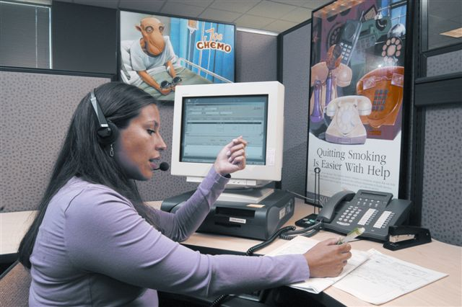
WHEN a PATIENT CALLS the QUITLINE
Caller is routed to language-appropriate staff
Brief Questionnaire
  Contact and demographic information
  Smoking behavior
Choice of services
  Individualized telephone counseling
  Quitting literature mailed within 24 hrs
  Referral to local programs, as appropriate
Quitlines have broad reach and are recommended as an effective strategy in the 2008 Clinical Practice Guideline.
Notes:
When a patient calls the quitline, a counselor or intake specialist answers. In most states, counseling is available in more than one language and the caller is routed to an appropriate staff member. A brief questionnaire is conducted, to assess contact and demographic information, smoking behavior, and type of service requested.
In most states, the quitline can refer callers to local programs, provide quitting literature by mail, and/or provide individualized telephone counseling. Some states are able to provide multiple counseling sessions (this is dependent on level of funding provided at the state level).
Quitlines have a broad reach and, as noted previously, are recommended as an effective strategy in the 2008 Clinical Practice Guideline (Fiore et al., 2008).
Fiore MC, Jaén CR, Baker TB, et al. (2008). Treating Tobacco Use and Dependence: 2008 Update. Clinical Practice Guideline. Rockville, MD: U.S. Department of Health and Human Services. Public Health Service.

Slide 44
What patients can expect When referred to the Quitline
Telephone counseling in language of choice
Five counseling sessions that includes patient assessment
A two week supply of over the counter nicotine replacement therapy (gum, lozenge or patch) mailed to their Texas address
Access to e-learning courses
Access 24/7 to Quitline services
Support if the patient experiences a trigger to use tobacco
A second referral can be made if not successful at first

Slide 45

Why use the quitline
Free service
HIPAA compliant: private and confidential
Refer as many times as needed
Enroll up to twice per year
Notes:
The Quitline helps to cover Texas’s geography. Services to help support a patient in their efforts to quit are not available in close proximity to many patients and the Quitline can help to eliminate this barrier.

Slide 46
Requirements for Quitline Services
Patient must have a Texas address
Patient is 18 years and older for counseling and nicotine replacement therapy
Counseling only for patient 13-17 years
Patient must have a USA phone number & must answer their telephone
Notes:
<Please emphasize the points on the slide and add others you think are important>

Slide 47



Texas Quitline Referral Methods
Paper-based fax referral
eTobacco Protocol
App referral
Notes:
There are 3 and potentially 4 ways to refer a patient to the Quitline.
<read from slide>

Slide 48
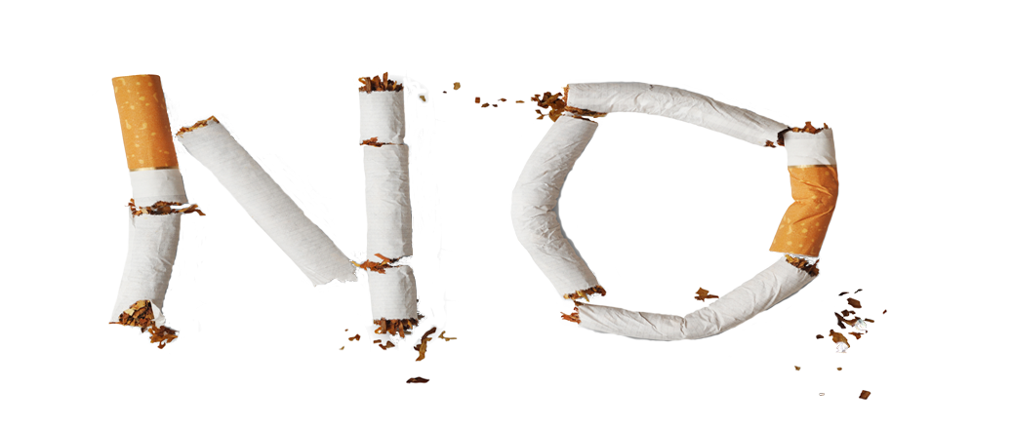
Ask-Advise-Refer Model
Ask if the patient uses tobacco.
Advise the patient to quit.
Refer the patient for assistance if ready to quit within 30 days.
Notes:
Each tool we will discuss will incorporate the format of an Ask, Advise, Refer model. What this means is the following:
ASK: healthcare providers already ask their patients if they use tobacco.
Patients who are ready to quit within 30 days have a greater chance of success and helps to leverage our resources in the most cost effective way.
ADVISE: The healthcare provider uses information and techniques provided in their training to advise the patient to quit tobacco.
REFER: After advising, the healthcare provider asks the patient for their approval and makes a referral to the Quitline using the App or tablet. The Quitline counsellor calls the patient within 48 hours to begin counseling and provide over-the-counter nicotine replacement therapy if appropriate. <If the health care system has integrated the eTobacco Protocol, the patient can be referred with the click of a button in the electronic medical record. With the eTobacco Protocol, the Quitline reports progress electronically back to the patient’s EHR so that the provider sees the results of the patient’s efforts to quit.>

Slide 49
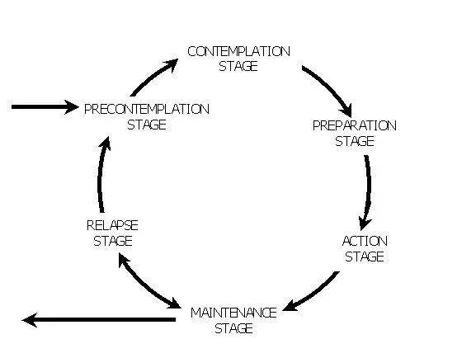
Stages of Change Model of OverComing Addiction
Pre-contemplative Stage - “This is not really a problem”
Contemplative Stage – Open to information, recognizes
negative impact of behavior
Preparation Stage – Planning for change, making decisions and gathering resources
Action Stage – Changing the behavior,
Maintenance Stage – Using the plans and resources to stick with new behaviors
Relapse Stage – Periods when addictive behaviors return
Notes:
The stages of change

Slide 50
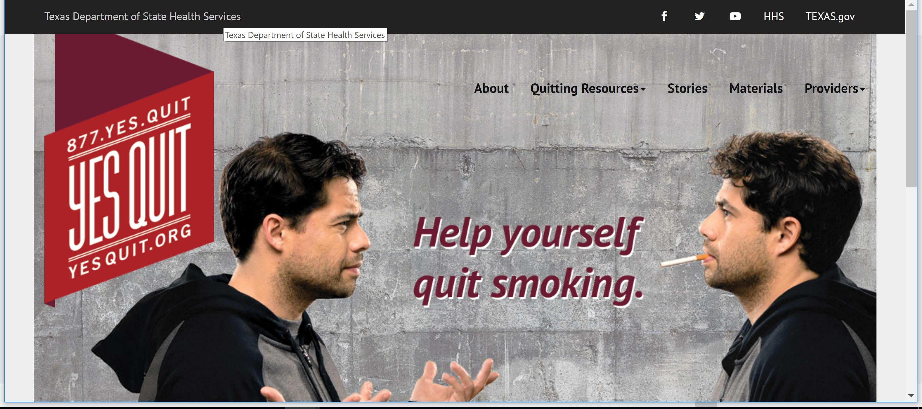
Notes:
First the web-based resources: This is the Texas It is available in both English and Spanish.

Slide 51
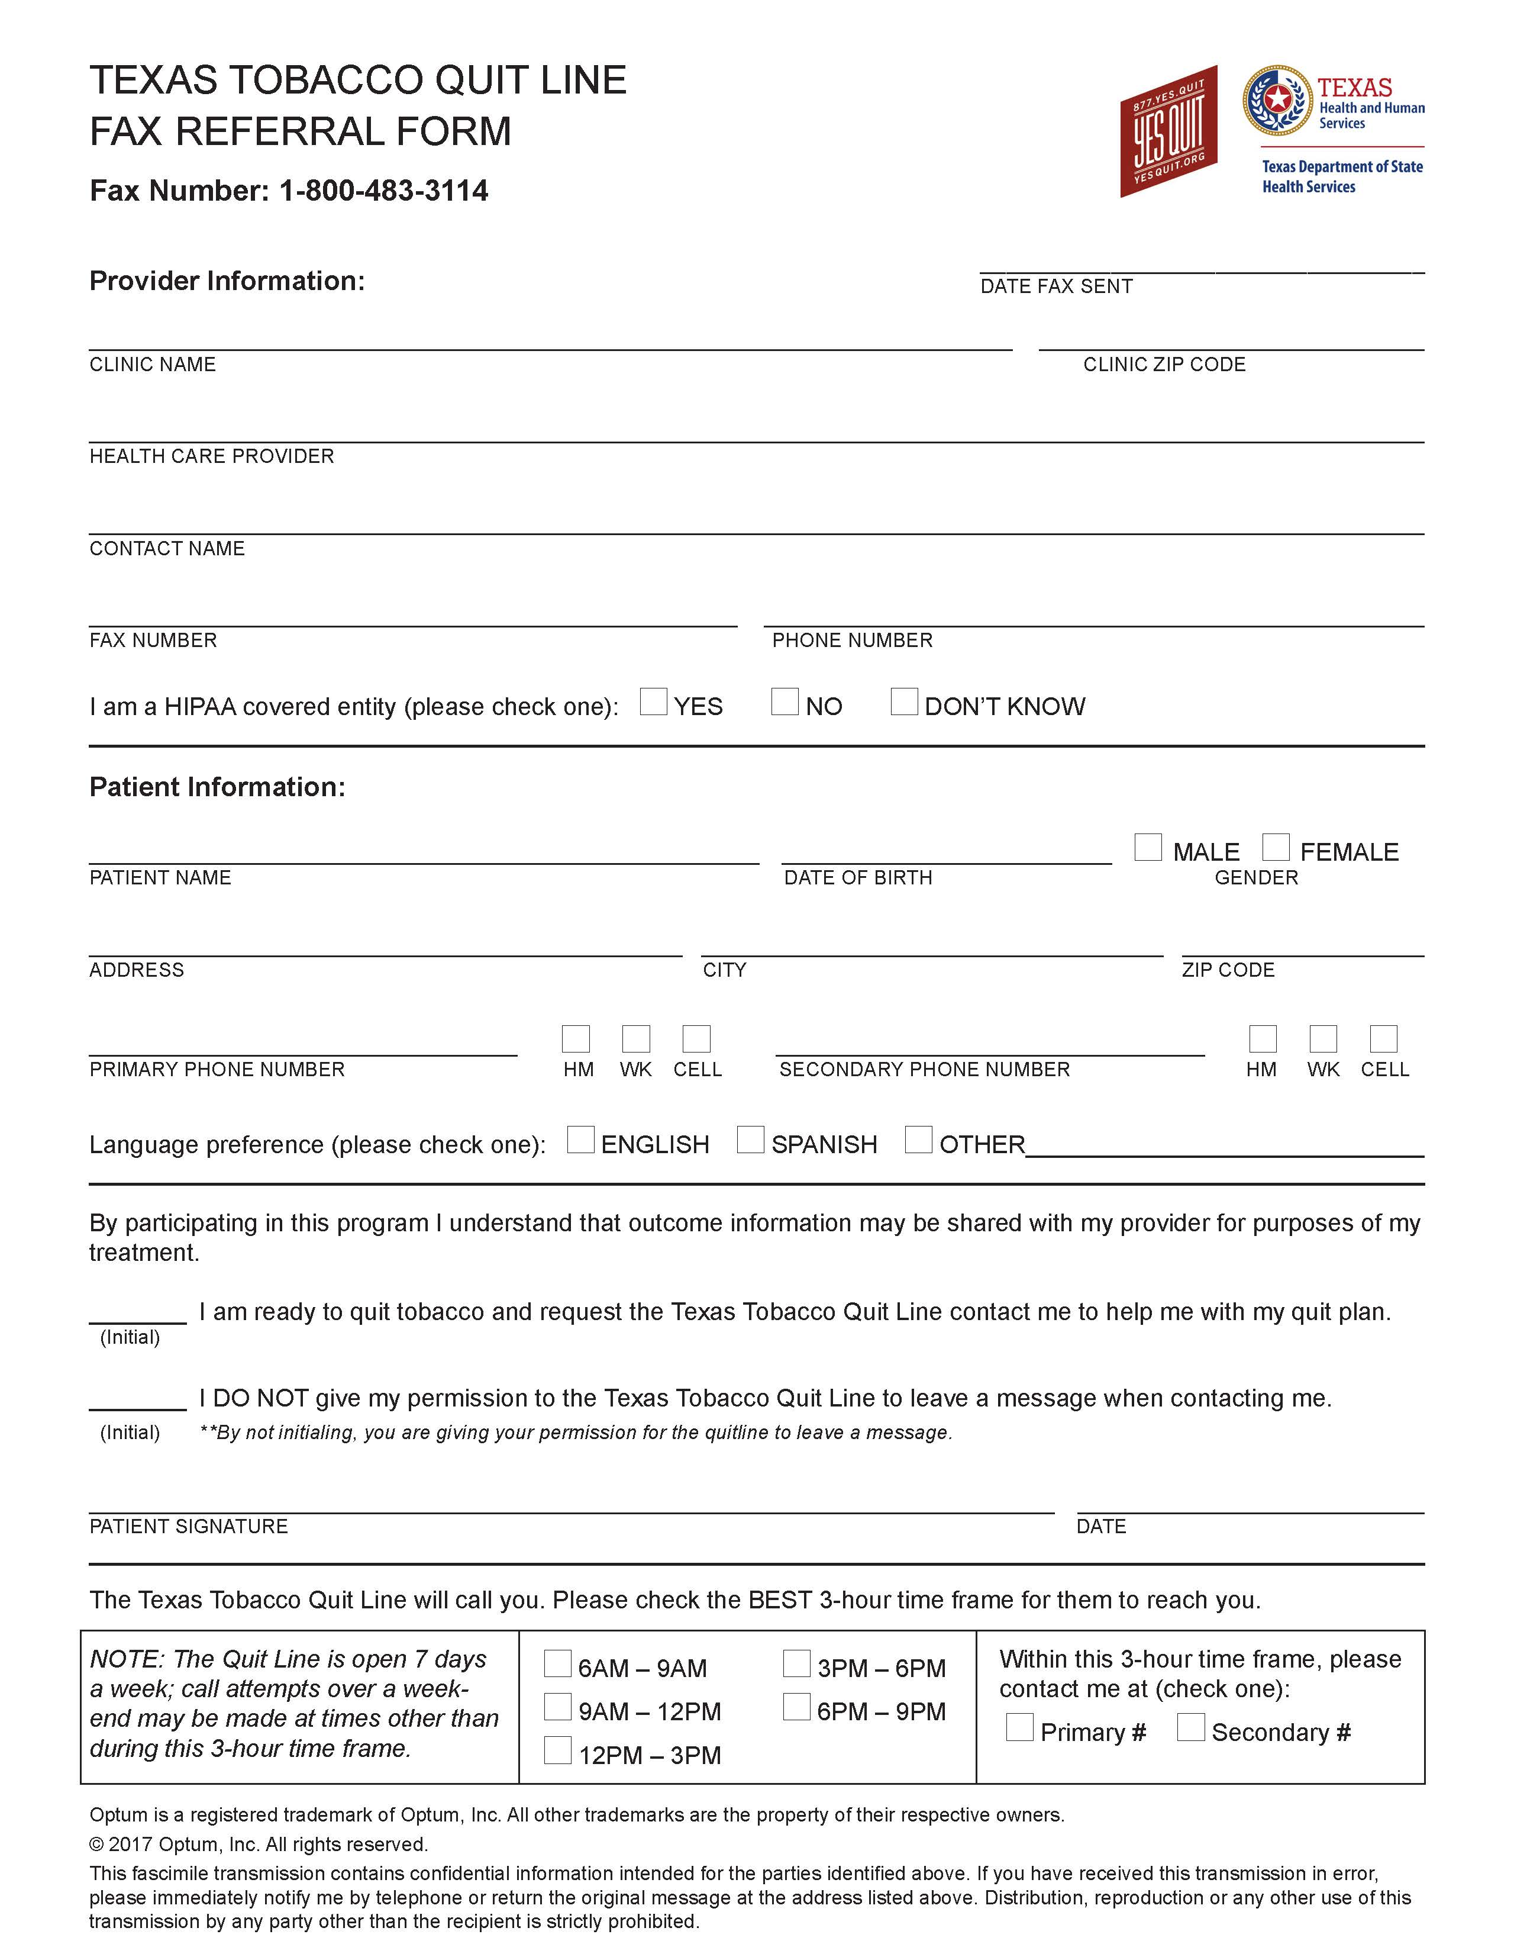
Notes:
This is a screenshot of the fax referral form.

Slide 52
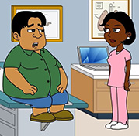
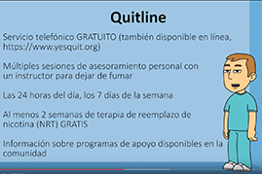
Tobacco Referral Training Resource
The Training video
YouTube: https://www.youtube.com/watch?v=qqNhyfXbEvg&feature=youtu.be
Information: UT Tobacco Research & Evaluation Team, 512.232.9307
Notes:
<The YouTube training video is available to provide insights into counseling techniques and the eTobacco Protocol. If you do not have access to the internet, click on the link in the first bullet or on the video located on your flash drive.>

Slide 53
eTobacco Protocol
Efficient counseling and referral option
Feedback to the Electronic Health Record (bidirectional interface)
Technical assistance
System impact
Revenue: bill Medicaid up to 3 minutes for counseling
HIPAA Compliant
Notes:
The eTobacco Protocol is an electronic integration designed to work with your electronic medical records systems. The goal is that after a patient is asked about tobacco use, they are then asked if they are ready to quit within 30 days. If the patient is ready, with the click of a radio button in the EMR , your staff can refer people electronically to the Quitline. Health systems that have the eTobacco Protocol will receive electronic feedback into the patients’ electronic health record and their health care provider will be able to see the progress being made to quit.
In the pilot phase of the eTobacco Protocol with Lone Star Circle of Care, we found that there were 7 fax paper referrals from that health care system prior to the integration of the Protocol, and more than 1200 following the integration. Following the pilot, we have worked towards raising awareness about the Protocol in all FQHC’s in communities with populations of 500,000 or less or with health systems that serve populations with disparities.
The eTobacco counseling fits into your workflow; some health systems may involve their community health promoters, medical assistants, nurses, etc., discharge planning etc.
Again, the Quitline is HIPPA compliant; only aggregate data is shared with the Department of State Health Services.

Slide 54


The Texas referral apps
Available - free
Available on both Android and iPhone platforms (and tablets)
Easy to use
Nice alternative if the eTobacco protocol is not available
Texas Quitline
Help to Quit

Slide 55
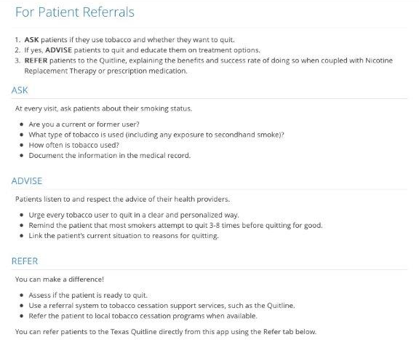
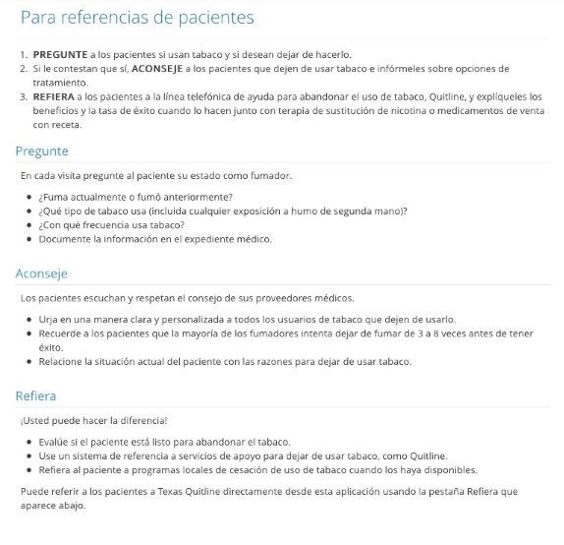
App Screen Shots
Notes:
The following are screen shots that provide an idea of how the app works. The app is bilingual, English and Spanish.
When the health professional or community health workers/promotores refer clients to the Quitline, they receive counseling and nicotine replacement therapy when they are 18 years or older.
We suggest that the Ask Advise Refer method can be used:
Ask the patient about tobacco use
Advise the patient about the benefit of quitting tobacco
Refer the patient to tobacco cessation resources, which in this case is the Quitline.

Slide 56
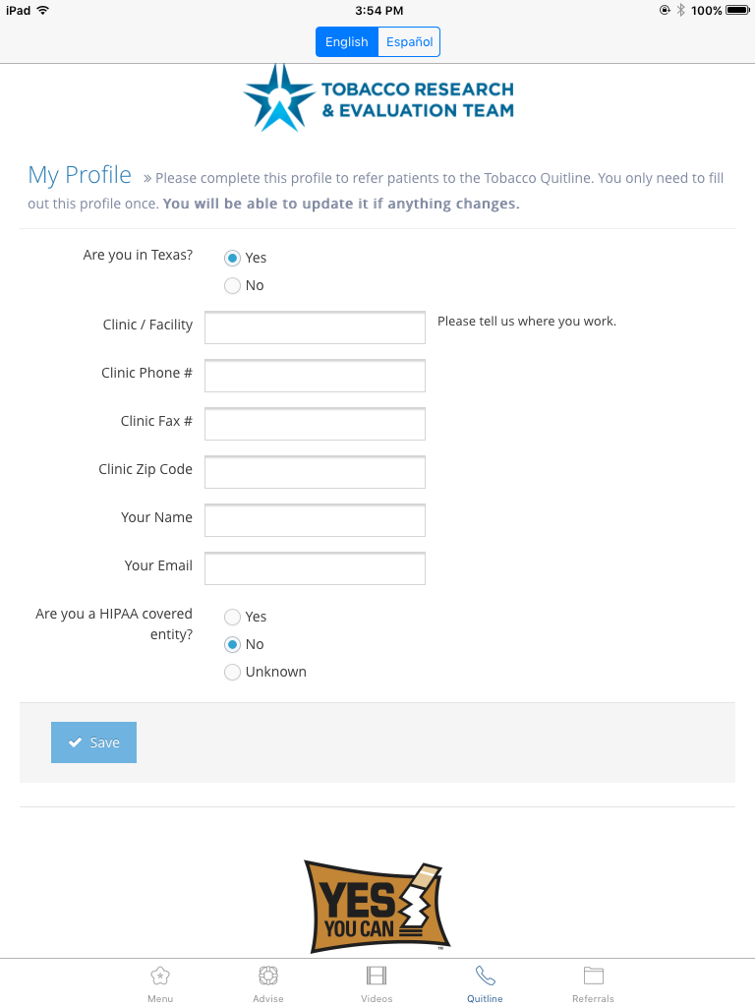
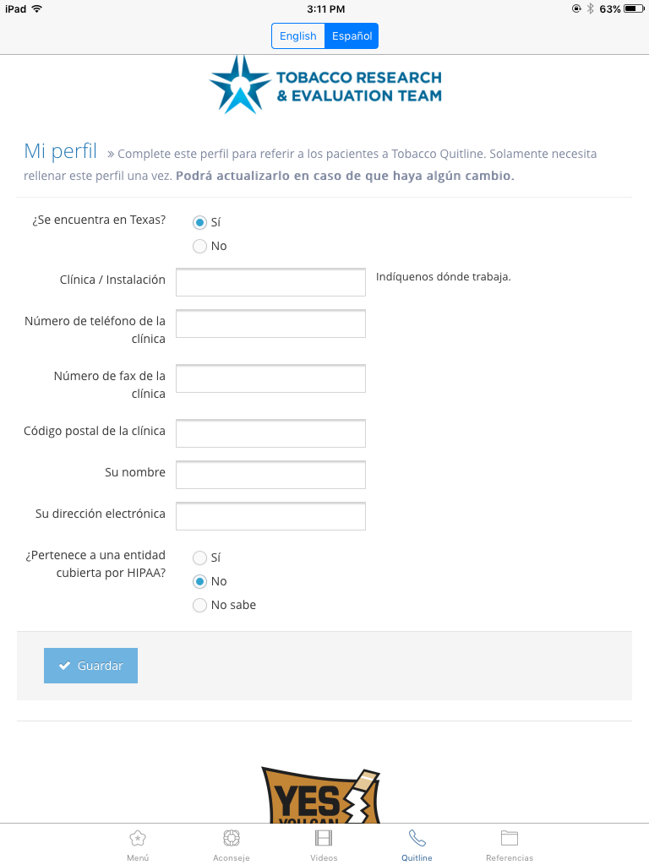
Provider Information

Slide 57
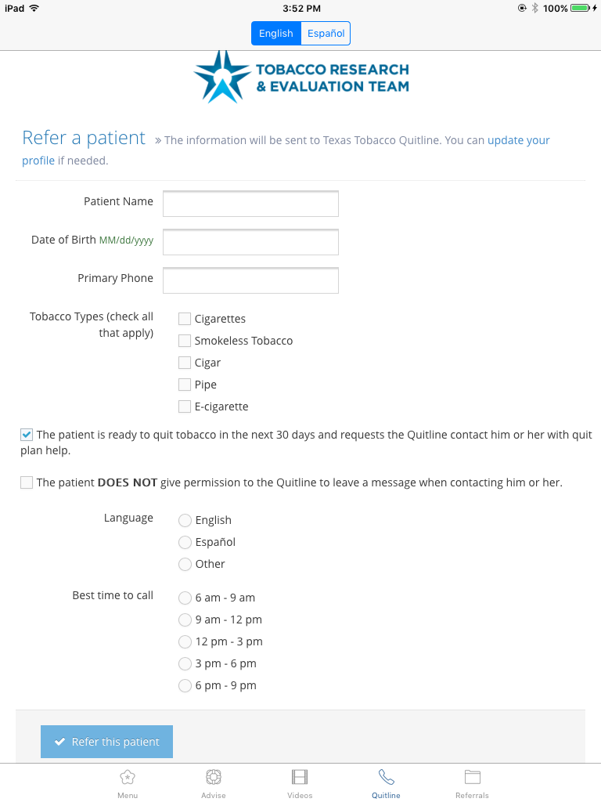
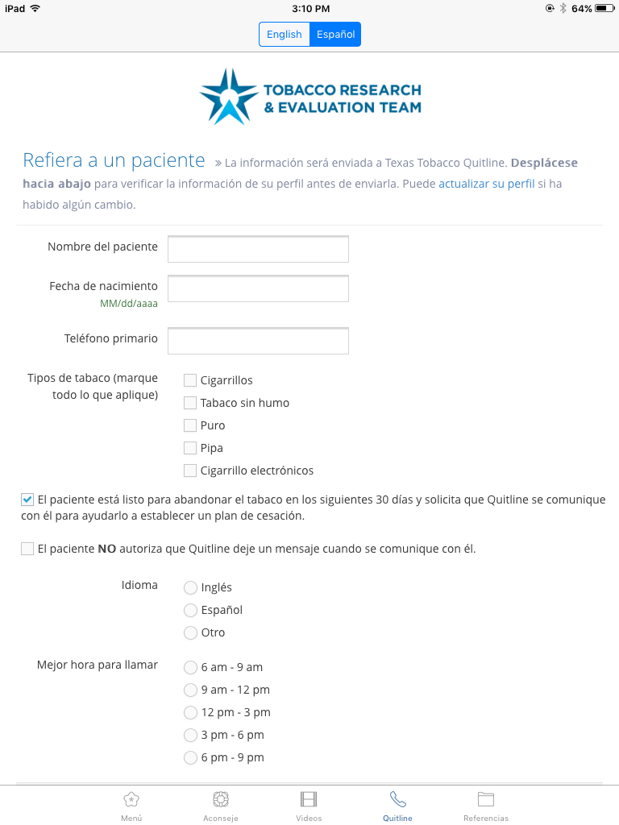
Screen Shots: Patient Information

Slide 58
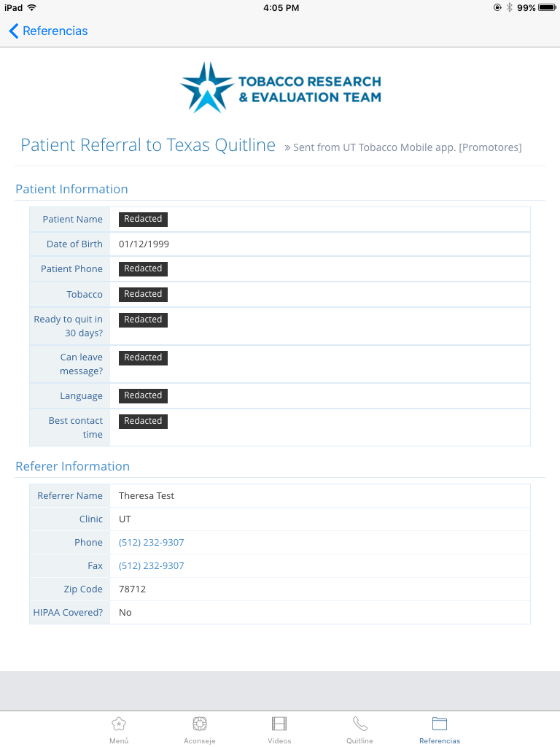

Screen Shots:
Referral Documentation

Slide 59
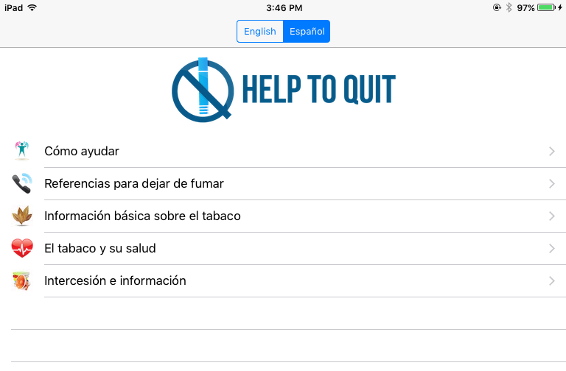
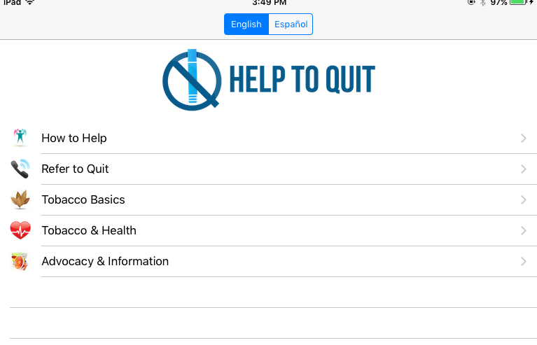
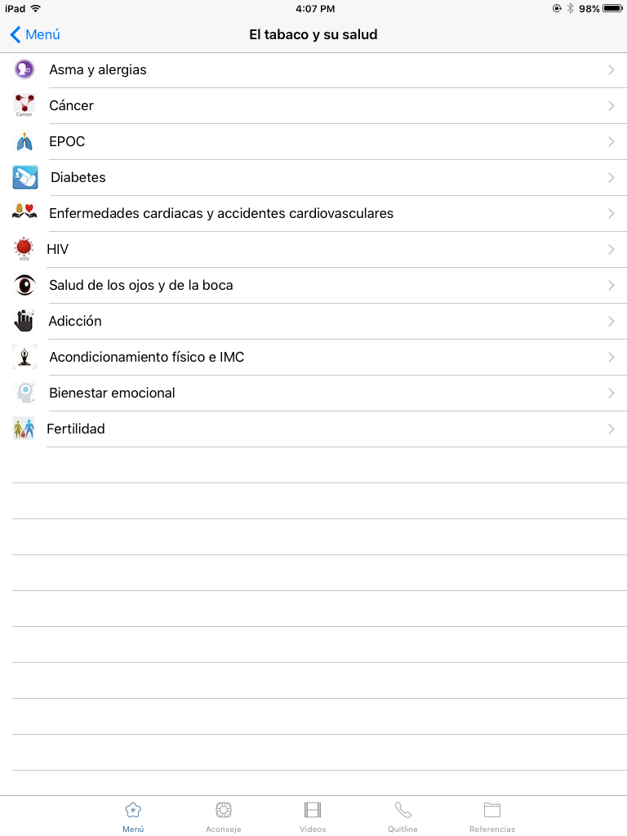
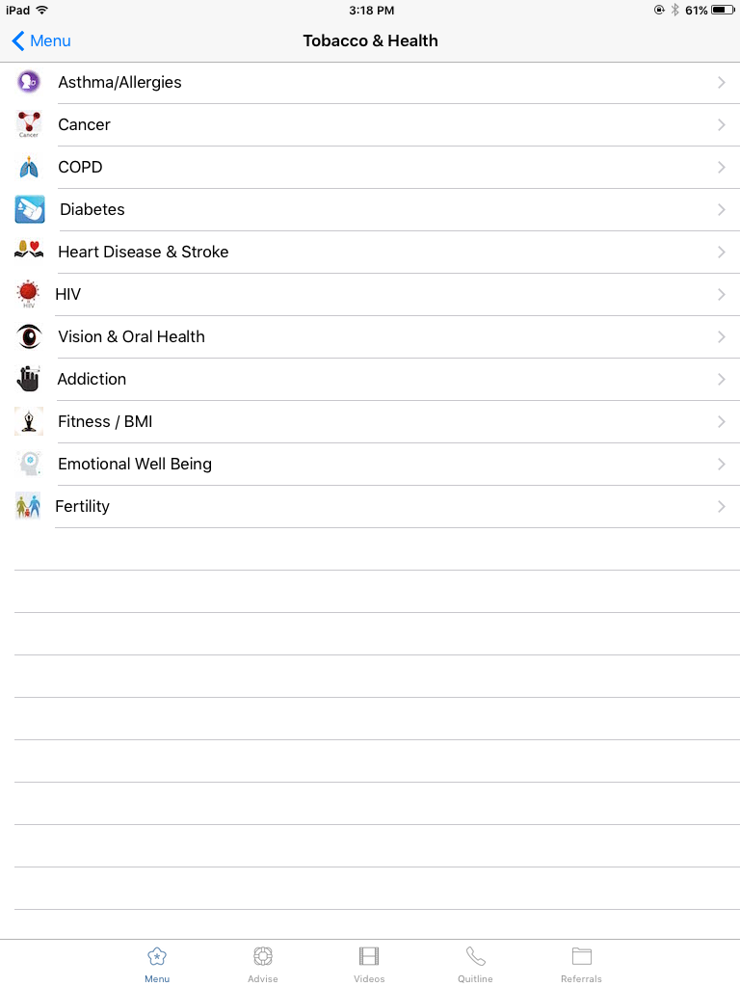
Screen Shots: Main Menu

Slide 60
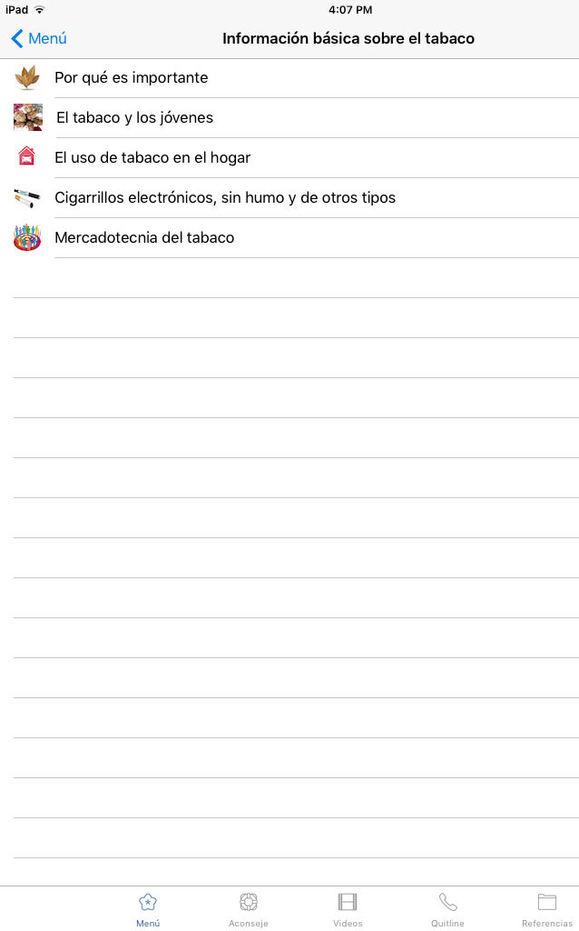
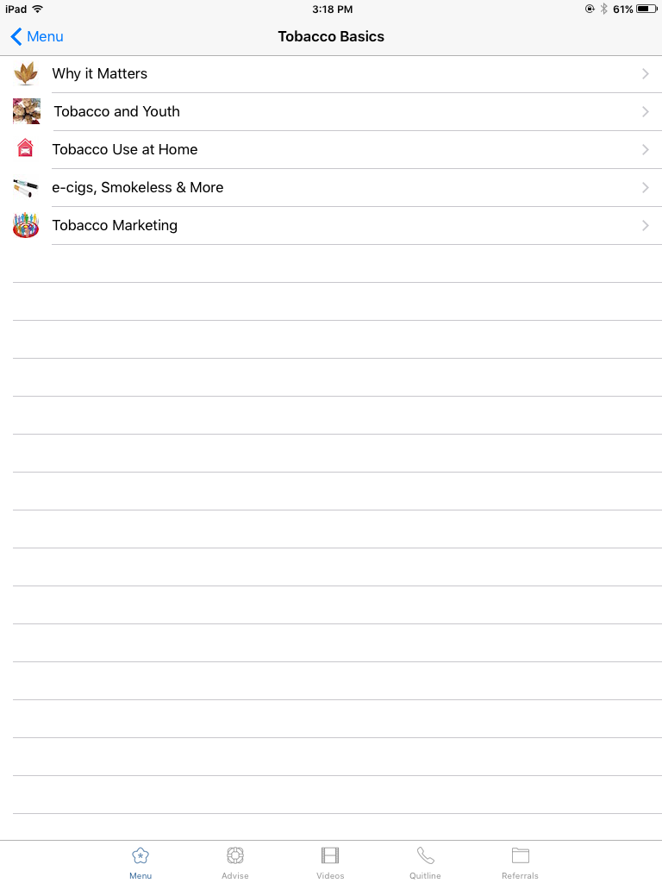
Tobacco basics Menu

Slide 61
Tobacco and Your Health Menus

Slide 62
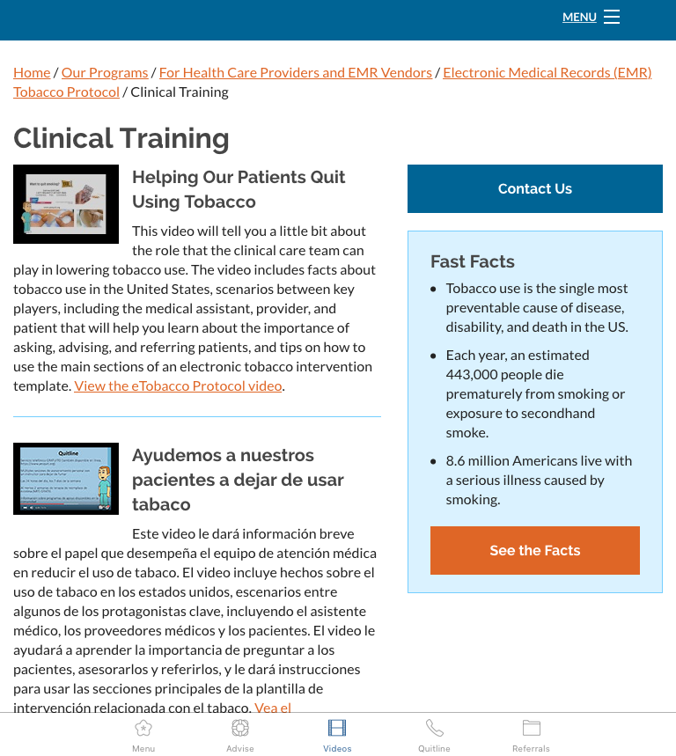
Screen Shots:
Videos

Slide 63
How can you help your patients?
Increase access to and appropriate use of effective support for quitting tobacco
Reduce patient out-of-pocket costs for quitting tobacco
Create a social and economic environment that promotes quitting
Save money
these resources can help your colleagues and friends too!

Slide 64
How can these free resources help you meet your goals?

Slide 65
Small Group Break out Session
Identify a facilitator an a reporter
Review scenarios and discuss how you would provide guidance
Use the Help to Quit app as a resource
Report back to the full room
Notes:
Explain small group work. There are 10 scenarios. Before dividing the groups, explain that each group will be assigned a scenario.
Each group should select a scribe and someone willing to report back to the larger group.
Based on what we have discussed so far, each group either role plays or discusses the scenario and comes up with a solution for that case.
Report back to the larger group after 45 minutes.

Slide 66
Questions?
For More information:
Tobacco Research and Evaluation Team - University of Texas at Austin
Trina Robertson, MA : trinar02@austin.utexas.edu
Ann Marie Newman : annmarie.newman@austin.utexas.edu
Phone: 512-232-9307

Slide 67
References:
2017 Texas Behavioral Risk Factor Surveillance System (BRFSS) Data on Tobacco. Prepared by Chronic Disease Epidemiology, Health Promotion and Chronic Disease Prevention Section, Texas Department of State Health Services
Use of Electronic Cigarettes and Any Tobacco Product Among Middle and High School Students — United States, 2011–2018 Karen A. Cullen, PhD; Bridget K. Ambrose, PhD; Andrea S. Gentzke, PhD; Benjamin J. Apelberg, PhD; Ahmed Jamal, MBBS; Brian A. King, PhD: MMWR / November 16, 2018 / Vol. 67 / No. 45 US Department of Health and Human Services/Centers for Disease Control and Prevention
Americans for Non –Smokers Rights https://no-smoke.org/smokefree-threats/electronic-cigarettes/
Centers For Disease Control And Prevention. Best Practices For Comprehensive Tobacco Control Programs – 2007, P. 15. Atlanta: U.S. Department Of Health And Human Services, Centers For Disease Control And Prevention, National Center For Chronic Disease Prevention And Health Promotion, Office On Smoking Or Health; October 2007.
Tobacco Use Among Adults With Mental Illness And Substance Use Disorders www.cdc.gov/tobacco/disparities/mental-illness-substance-use/index.htm
Smoke-free Public Housing And Multifamily Properties https://www.hud.gov/program_offices/healthy_homes/smokefree
The Stages of Change Model of Overcoming Addiction; 2018: Elizabeth Hartley, Phd; Steven Gans, MD https://www.verywellmind.com/the-stages-of-change-model-of-overcoming-addiction-21961

